Slide 1
PREDICTION OF USER BEHAVIOR IN SOCIAL NETWORK
PROJECT REVIEW
Presented by
M.DHANASEKAR - 510819205002
R.PRIYANKHA - 510819205010
On 22-05-2023
PROJECT GUIDE PROJECT COORDINATOR
Mr. D. DURAI KUMAR Mr. D. DURAI KUMAR
HOD/IT HOD/IT

Slide 2
OBJECTIVE
The main objective of our project is to predict the state of mind of the users by analyzing their chats in social network using NLP and Machine learning Techniques.

Slide 3
ABSTRACT
This Project focuses on analyzing social media chats of the user through NLP and Machine learning techniques.
In existing system, the analysis is done on a daily, weekly, or monthly basis as allowing the user to see patterns of usage and potentially make changes to their habits using deep learning techniques.
The proposed system will utilize various methods, including examining individual words, sentences, paragraphs , voice and audio analysis.
To enhance the accuracy of the analysis, we use machine algorithms called LSVC and LSTM .
The results of the analysis will provide valuable insights into the communication patterns in social media chats.

Slide 4
INTRODUCTION
The number of social networking sites or social media users has increased significantly over the last decade.
User behaviour Prediction involves the use of Natural language processing techniques to develop models for sentiment analysis, using publicly available datasets of social media posts and messages.
These models will be trained to recognize different sentiment categories, such as positive, negative, or neutral and behaviors like clever, crime, short-temper, friendly, helpful, etc. and will be tested on real-world data from social networks.
It has several potential applications, including early detection of mental health issues, personalized treatment, online safety, and improved policing strategies.

Slide 5
LITERATURE SURVEY

Slide 6
l
S.NO | TITLE | AUTHOR | YEAR | ALGORITHM/ METHODOLOGY/ TECHNIQUES | INFERENCE
1 | User Behavior Analysis on Social Media data using Sentiment Analysis or Opinion Mining | Nirmal Varghese Babu, Fabeela Ali Rawther | 2019 | Sentimental analysis, Decision Tree. | Limited Scope, Limited Applicablity.
2 | Prediction of User Sentiment on COVID-19 Pandemic Using Tweets | Nilufa Yeasmin, Dr. Mohammad Abdul Azim, | 2022 | Logistic Regression | Low accuracy Ambigious .
3 | People’s Behaviour Analysis in Chat Message using Natural Language Processing | V.Selina Annie Retna, Prof. P. Brundha Dr.G. RajKumar | 2022 | Natural language processing | Limited language support, Can predict only text based messages.

Slide 7
EXISTING SYSTEM
The system focuses on the extraction of the WhatsApp chat and was considered for the sentimental analysis using the deep learning model.
The project was made to undergone the flirt analysis in the WhatsApp chat and it was implemented by categorizing the sentences as positive, negative or neutral.
This method analyzes the chats using natural language processing by collecting various persons data and thus made them to the processing stage to obtain the results.
ADVANTAGE:
User-Friendly.
DISADVANTAGE:
Not applicable for complex sentences.

Slide 8
PROBLEM IDENTIFICATION
The major problems with the existing system are as follows:
Not suitable for analyzing complex sentences.
Limited language support.
Can predict only text based messages.

Slide 9
PROPOSED SYSTEM
The proposed system incorporates single words, sentences, paragraph, voice and audio file analysis.
Using NLP techniques such as tokenization, sentiment analysis, named entity recognition, and topic modeling will gain a deeper understanding of the content and sentiment of the text.
Rule-based, machine learning-based, and aspect-based approaches will enable to predict the sentiment of the text, which can be useful for understanding how users are feeling about particular topics or issues.
Here we use LSVC and LSTM machine learning algorithms to predict user behavior based on their texts in social networks.
ADVANTAGES:
Can predict audio based messages.
No language barriers.

Slide 10
SYSTEM SPECIFICATION
HARDWARE REQUIREMENTS
Hard Disk : 500GB and Above
RAM : 4GB and Above
Processor : i3 and Above
SOFTWARE REQUIREMENTS
Operating System : Windows 10 (64 bit)
Software Editor : PyCharm
Language : Python

Slide 11
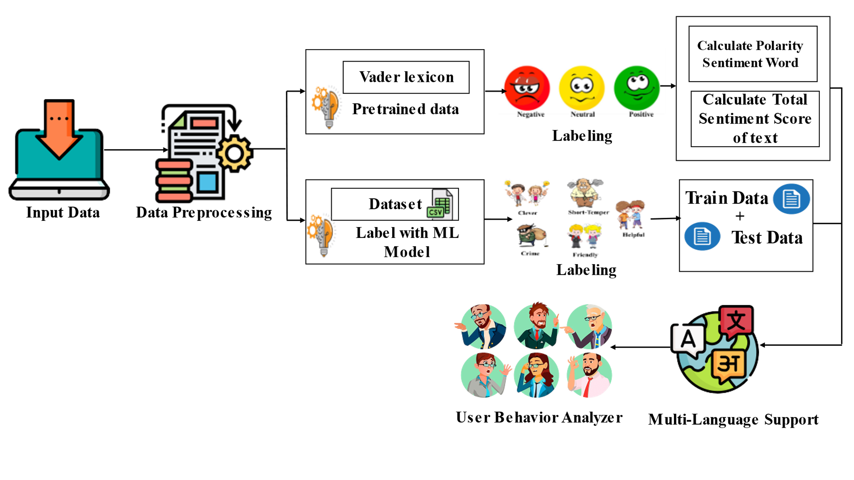
SYSTEM DESIGN

Slide 12
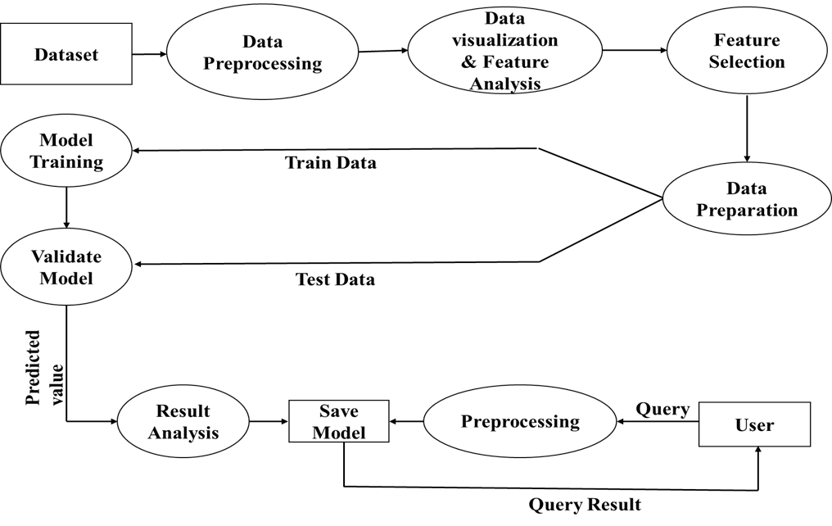
DATA FLOW DIAGRAM

Slide 13
PROJECT DESCRIPTION
MODULES
The proposed system consists of five modules . They are as follows:
Data collection.
Data Preprocessing.
Model Selection.
Evaluation and Validation.
Prediction Results.

Slide 14
DATA COLLECTION
Data collection is typically involves gathering large volumes of text data, such as social media posts, product reviews, customer feedback, news articles, and blogs.
The data can be collected manually or through web scraping tools that automatically extract data from websites.
Also, data can be extracted from the user manually using exported chat document , twitter dataset, posts, comments, etc.
One important consideration when collecting User Behaviour data is to ensure that the data is diverse and representative.
This means collecting data from a wide range of social media users, including those with different dialects or accents, and those who use different mode of texting.

Slide 15
DATA PREPROCESSING
Data preprocessing is used for cleaning the data and making it suitable for a machine learning model which also increases the accuracy and efficiency of a machine learning model..
To preprocess the collected data NLP techniques such as tokenization, stemming, lemmatization ,topic modelling are used.
Additionally, the data may be normalized, filtered, or transformed as necessary to ensure that it can be used for analysis.
The technique used for feature extraction is TF-IDF in natural language processing (NLP) to transform text data into numerical features that can be used for machine learning algorithms.

Slide 16
MODEL SELECTION
Once the features are extracted, machine learning models are used to predict user behavior based on input.LSVC is a machine learning algorithm used for classification tasks. It is a variant of the Support Vector Machine (SVM) algorithm.
Long Short- Term Memory (LSTM) networks are a modified version of recurrent neural networks, which makes it easier to remember past data in memory. It is used for predicting audio to text analysis.
NLP is used to predict the sentiment of the sentence and behaviour of the user.
The training process involves optimizing the model's parameters to minimize the classification error. To do this, the LSVC and LSTM algorithms can be trained on a dataset of text samples that are labeled with their corresponding behaviours such as Friendly, clever, crime, depression etc.

Slide 17
EVALUATION AND VALIDATION
The purpose of evaluation is to determine how well the model can generalize to new data. Common evaluation metrics for classification tasks include accuracy, precision, recall, F1-score, Support.
The model is trained on the training set and evaluated on the validation set. We will perform model training with a LSVC and LSTM.
This process helps to detect overfitting, which occurs when the model performs well on the training set but poorly on the validation set. 80% of training data and 20% as testing data are used for prediction.

Slide 18
PREDICTION RESULTS
In this phase, once the input data is given the other attributes which are necessary for the prediction is retrieved.
The extracted information of the user from the dataset is fed into the model to predict the final result.
Once the input data is preprocessed, it is fed into the LSVC and LSTM, which will generate a prediction or outcome as behaviour.
The predicted result primarly depends upon state of mind of the user and express sentiment and behaviors of the message given as input.

Slide 19
CONCLUSION
The predictive analysis can help businesses to optimize their marketing campaigns and increase customer engagement.
This information can be leveraged by businesses, organizations, and individuals to improve marketing, customer service, brand management and communication strategies.
Overall, user behavior prediction has the potential to revolutionize the way businesses interact with their customers and improve their understanding of user in social networks.

Slide 20
FUTURE SCOPE
The future scope of our project includes exploring additional data sources such as video and social media activity, developing real-time prediction models, incorporating sentiment analysis to better understand users emotions and attitudes, personalizing recommendations based on predicted user behavior, and exploring the application of these techniques in different domains such as healthcare, finance, or education.

Slide 21
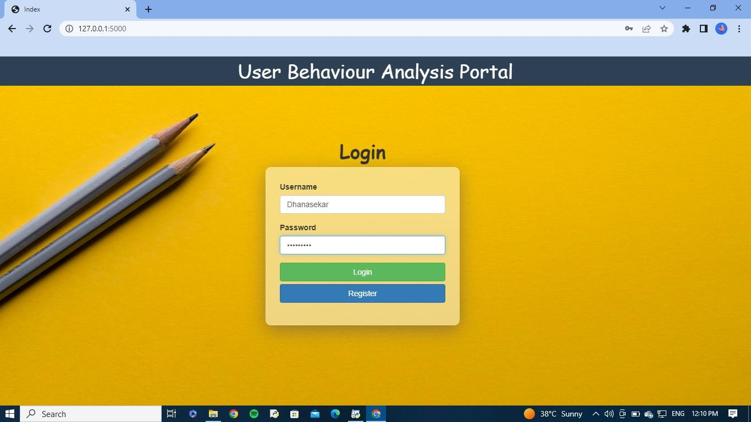
SCREEN SHOTS
USER LOGIN

Slide 22
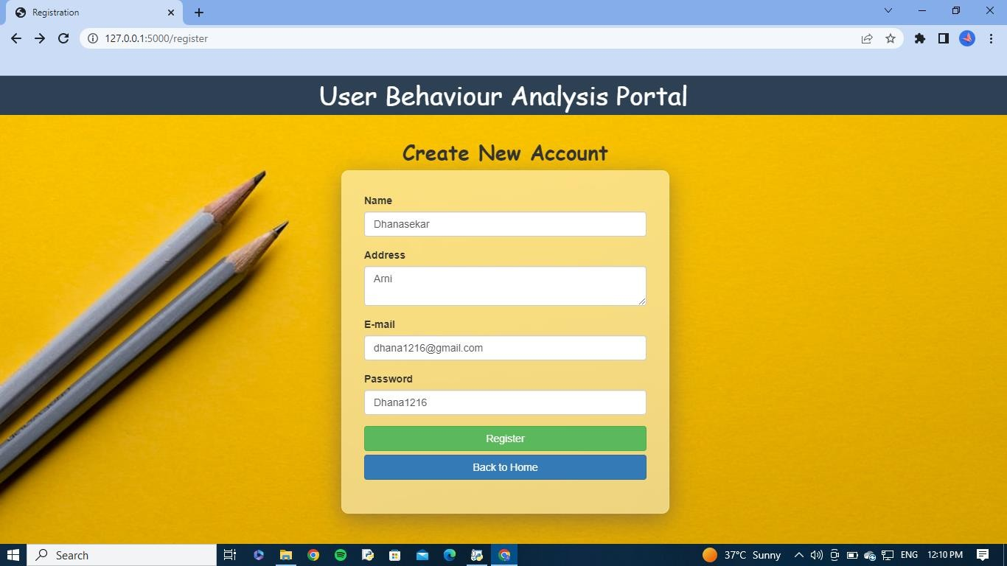
USER REGISTRATION

Slide 23
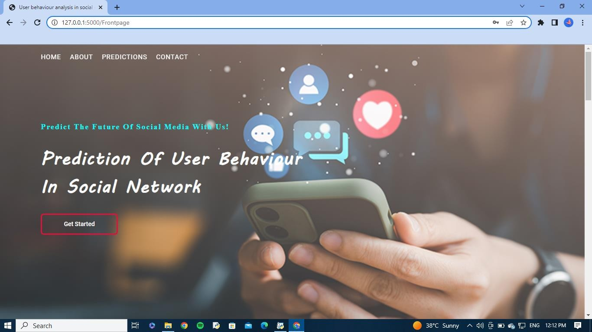
HOME PAGE

Slide 24
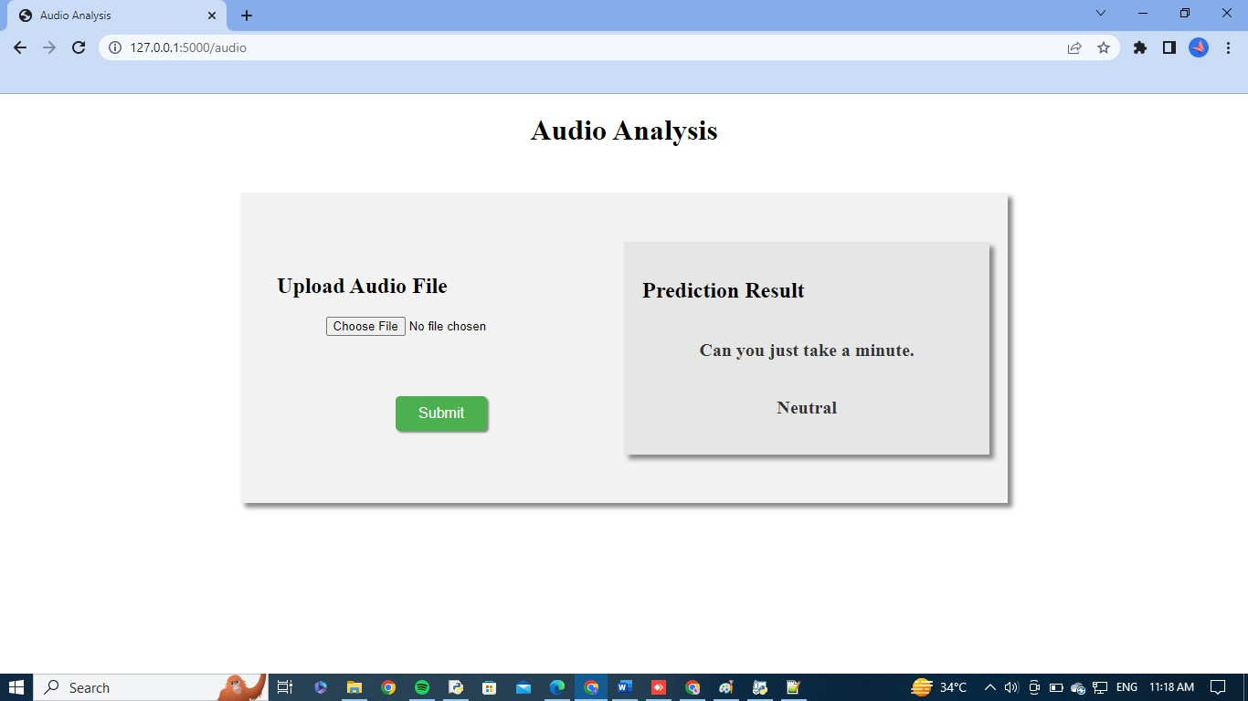
AUDIO ANALYSIS

Slide 25
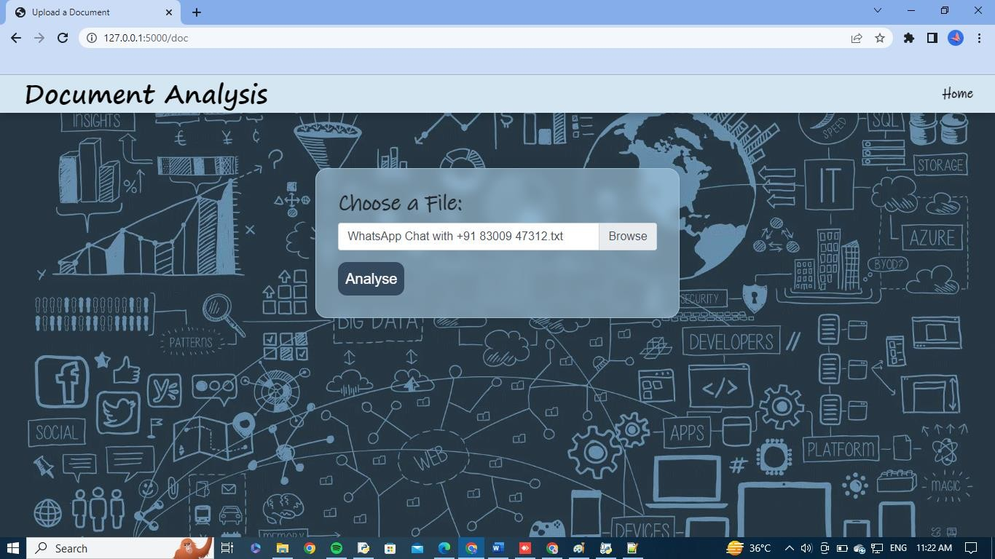
DOCUMENT ANALYSIS

Slide 26
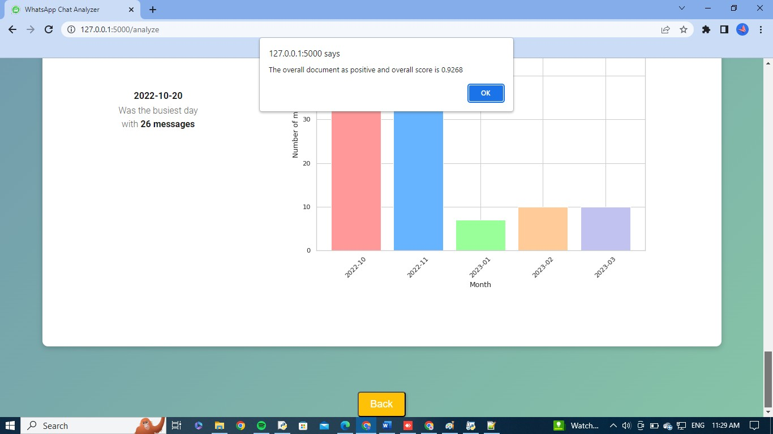
RESULT OF DOCUMENT ANALYSIS

Slide 27
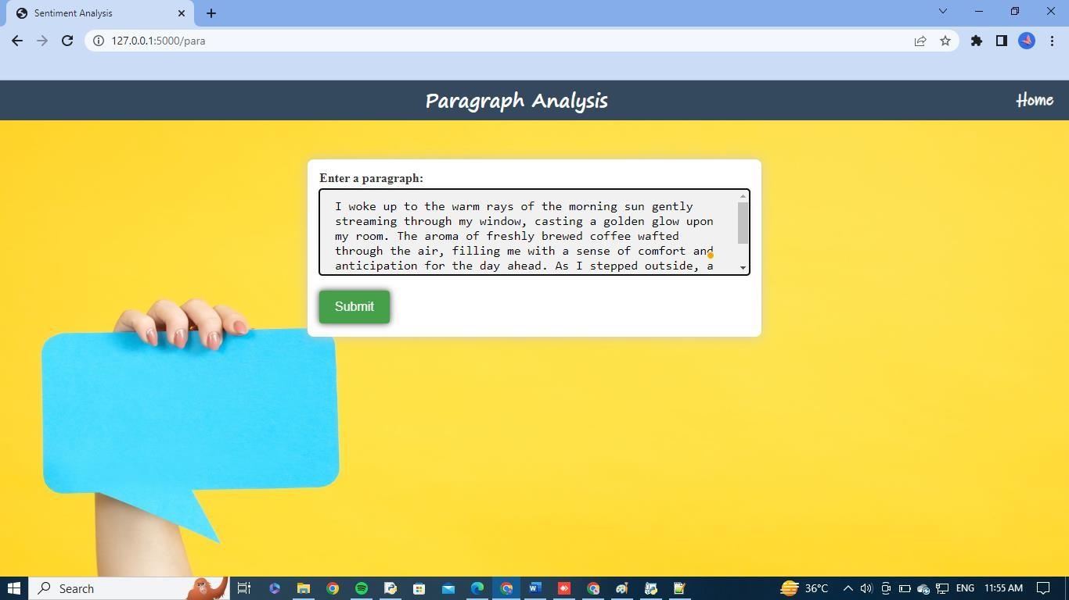
PARAGRAPH ANALYSIS

Slide 28
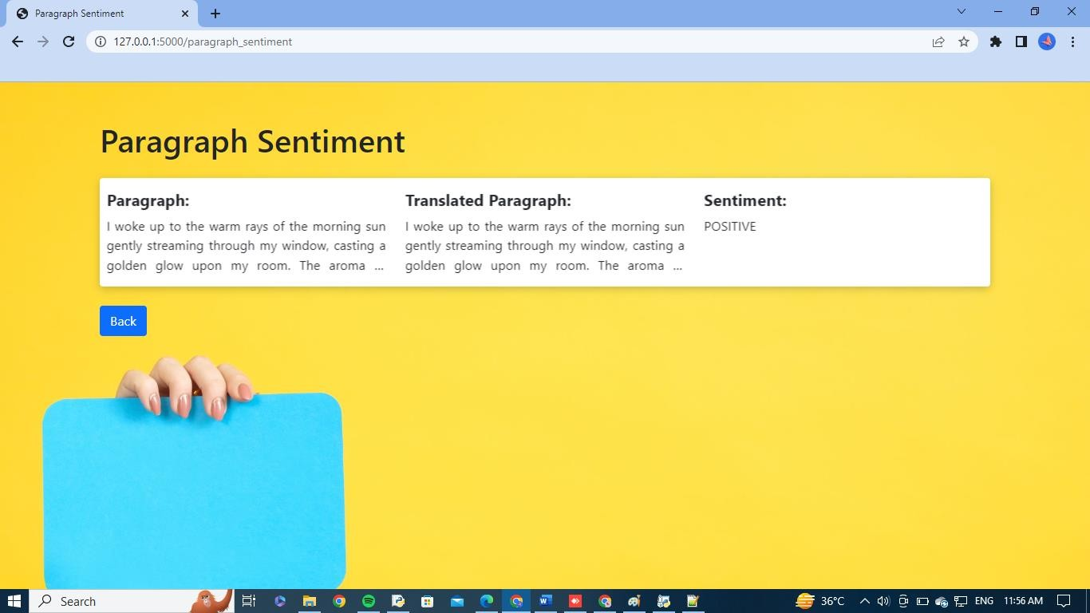
RESULT OF PARAGRAPH ANALYSIS

Slide 29
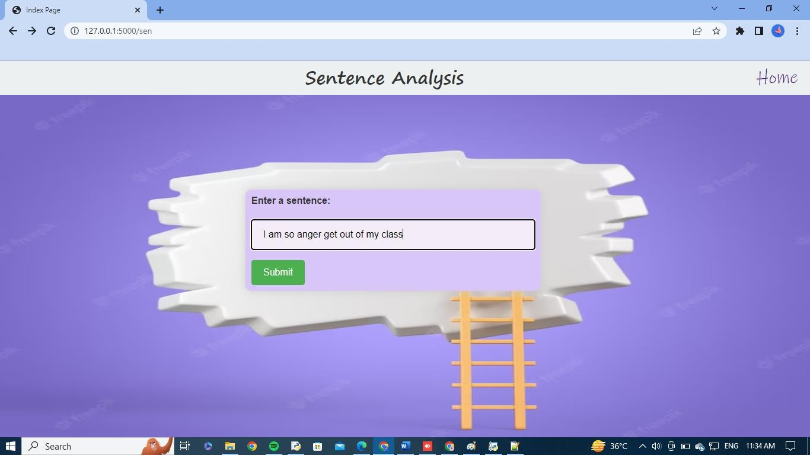
SENTENCE ANALYSIS

Slide 30
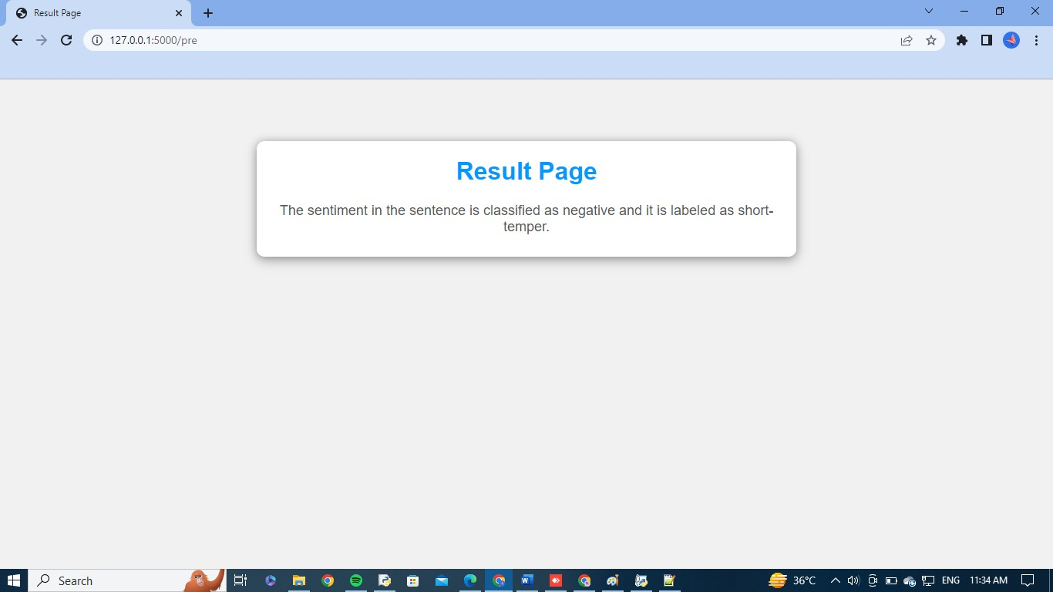
RESULT OF SENTENCE ANALYSIS

Slide 31
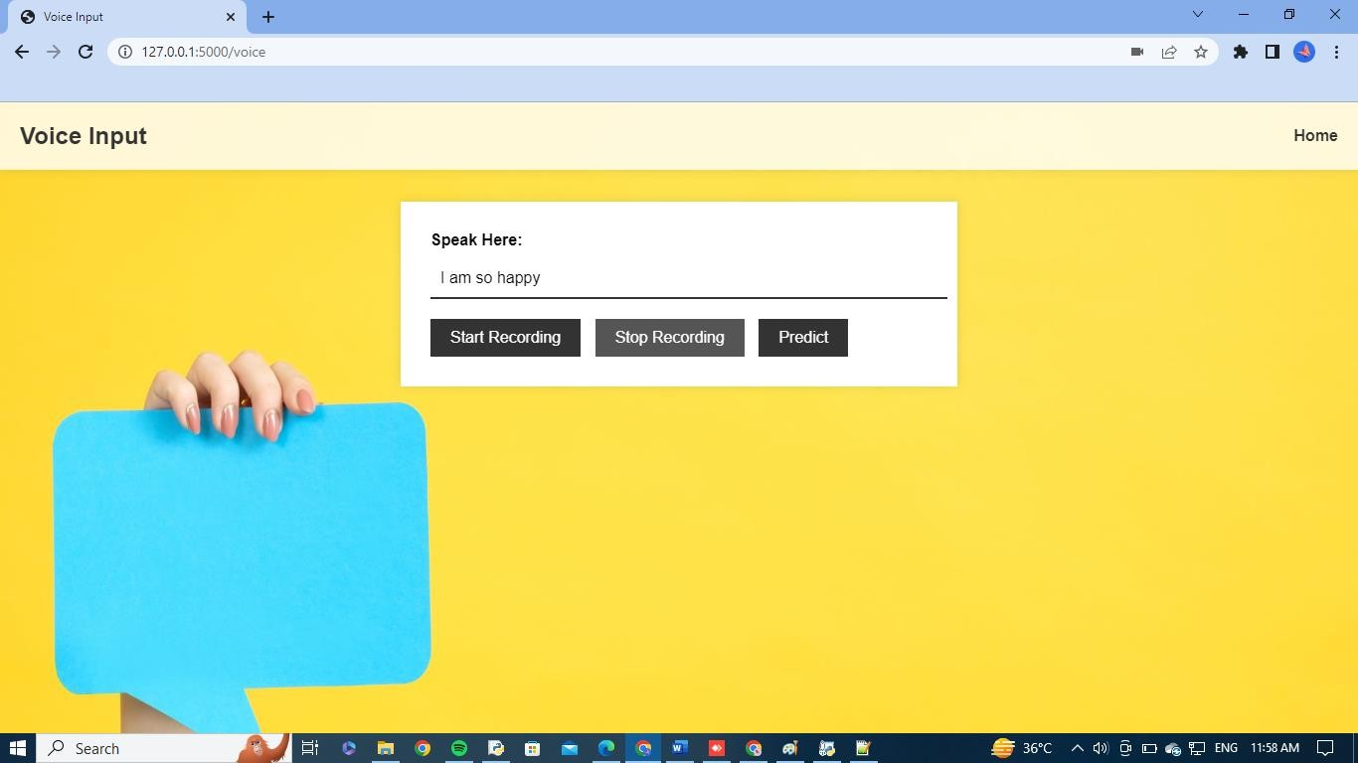
VOICE ANALYSIS

Slide 32
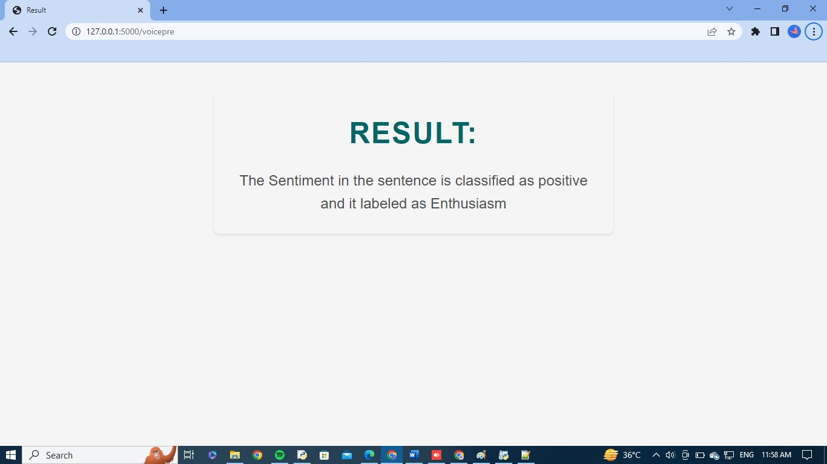
RESULT OF VOICE ANALYSIS

